Slide 1

A data-driven framework for diabetic peripheral neuropathy risk prediction using foot thermograms
Name | USN
Agasthya Samyak Jnan | 02JST22UCS006
Jayanth S | 02JST22UCS043
Arvind Ningombam | 02JST22US017
Prajwal T P | 01JST21CS099
Under the guidance of
Amaresh A M
Assistant Professor
Department of CS&E
SJCE, JSS STU Mysuru

Slide 2

Introduction
Diabetes mellitus is a chronic metabolic disorder affecting millions worldwide.
One of its serious complications is diabetic peripheral neuropathy, which can lead to foot ulcers and amputations.
Early identification of abnormal foot conditions is crucial to prevent severe outcomes.
Infrared thermal imaging provides a non-invasive, contactless, and safe method to observe foot temperature patterns.

Slide 3
Motivation and Project Focus
Neuropathic changes often manifest as thermal asymmetry and hotspots in thermal foot images.
Manual interpretation of thermal images is subjective and requires expert knowledge.
Machine learning and deep learning can automate thermal pattern analysis.
This project focuses on risk classification (Low / Moderate / High), not medical diagnosis.

Slide 4
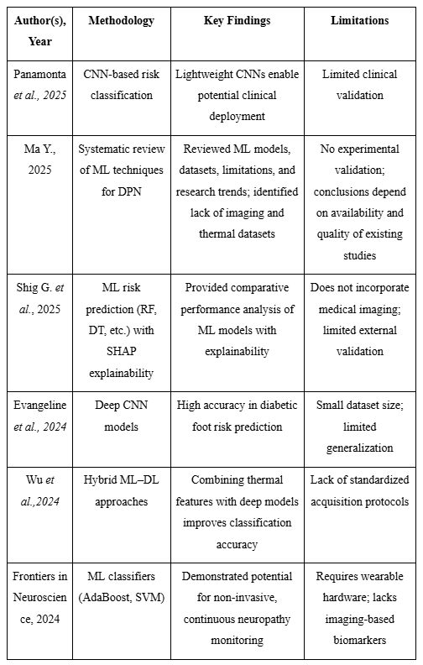
Literature Review: Existing Research

Slide 5
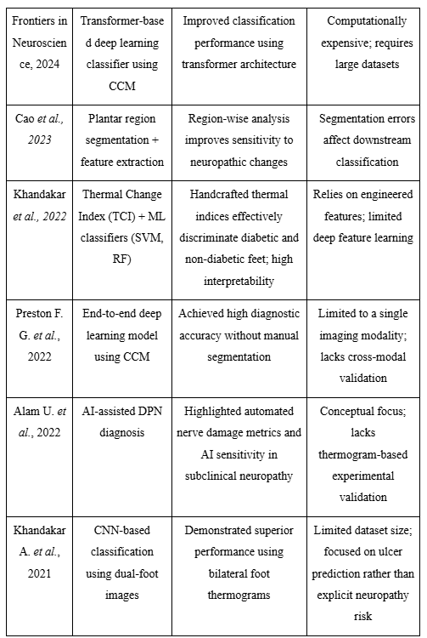
Literature Review: Existing Research

Slide 6

Identified Research Gap
Risk Stratification
CNN Output Integration
Most existing works focus on binary diagnosis, not risk stratification.
Limited integration of CNN outputs with global thermal statistical features.
Lightweight CNN Benchmarking
Few studies benchmark lightweight CNNs for thermal foot images.

Slide 7
System Requirements and Analysis: Functional Requirements
Load and preprocess thermal foot images.
Perform data augmentation to expand dataset and improve generalization.
Train CNN-based binary classifiers.
Extract global thermal features from images based on medical thermography methods.
Generate risk scores based on classifier output and global thermal features and classify risk levels.

Slide 8

Non-Functional Requirements
Reliability & Reproducibility
High reliability and reproducibility of results.
Modular & Scalable
Modular and scalable system design.
Efficient Computation
Efficient computation suitable for limited resources.

Slide 9
Tools and Technologies Used: Software and Frameworks
Programming Language
Python
Deep Learning Framework
TensorFlow / Keras
Image Processing
NumPy, OpenCV
Visualization
Matplotlib
Model Evaluation
Scikit-learn

Slide 10
Models and Platform
Pretrained CNN Architectures:
Training Platform:
EfficientNet-B0
Google Colab, VS Code
MobileNetV2
Dataset Handling:
XGBoost
Directory-based generators
Experiment Management:
Versioned model saving and experiment logging

Slide 11
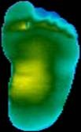
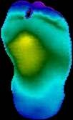
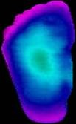
Dataset and Preprocessing
Plantar thermograms from the publicly available IEEE Dataport plantar thermogram dataset and its Kaggle mirror version were used in this work. The source dataset has bilateral thermal foot images divided into non-diabetic (control) and diabetic subjects.
Preprocessing methods like Image Resizing, Normalization, Data Augmentation (Rotation, Intensity Variations, translation, zooming etc.), Splitting, Batching and Shuffling were done to help train the models efficiently.
The initial split distribution is:
Training set: 720 Control, 724 Diabetes affected (DM) - 1444 training images
Validation set: 170 Control, 252 Diabetes affected (DM) - 422 validation images
After applying the augmentation pipeline independently to both subsets, the dataset expanded to:
21,660 training images
6,330 validation images
(a) (b) (c)
Samples from augmented dataset corresponding to neuropathic risk : (a) Low risk (b) Medium risk (c) High risk foot images

Slide 12
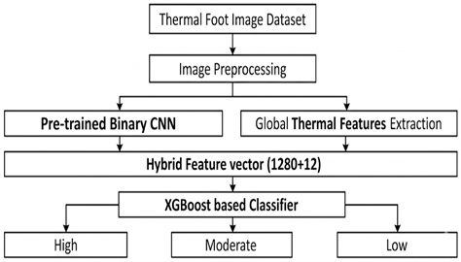
System Design
CNNs learn complex spatial thermal patterns.
Global thermal features add physiological interpretability.
Hybrid design improves robustness.
Risk-based output avoids clinical overclaiming.
Modular pipeline enables easy extension.

Slide 13
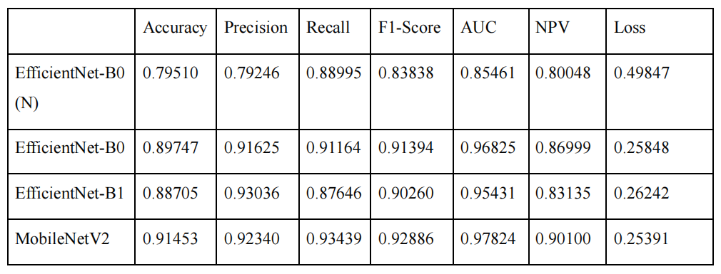
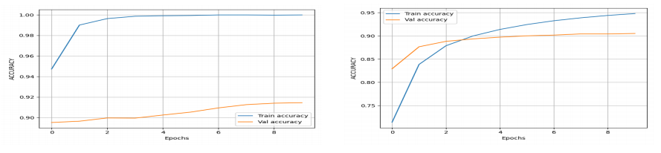
System Implementation: Image Processing and CNN Model Training
Thermal images are batched, shuffled, resized to 224x224, and normalized before training and validation.
The training is done in two stages: feature extraction and fine tuning
Pre trained layers are initially frozen to stabilize learning.
Selected deeper layers unfrozen for fine tuning and better generalization.
Performance of various models are evaluated using multiple metrics
Comparison of performance of different Pre-trained CNN backbones.
Accuracy Plots of Training and Fine Tuning of MobileNetV2 based Classifier Model.

Slide 14
System Implementation: Dataset Risk Labelling
Risk labels generated using an unsupervised thermal analysis approach
Thermal features extracted from the HSV (V-channel) of foot thermograms
Computed features: mean temperature, standard deviation, entropy, and left–right asymmetry
Thermal Risk Score (TRS) calculated to quantify abnormal heat patterns
TRS = 0.4×Mean + 0.3×Std + 0.3×Entropy
K-Means clustering (k = 3) applied on normalized thermal features
Clusters ranked by TRS and labeled as Low, Moderate, and High risk

Slide 15
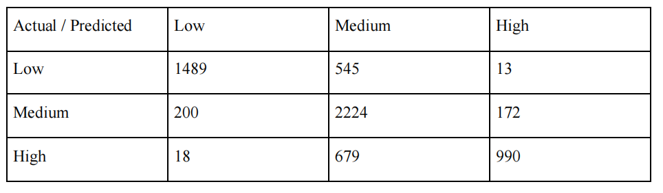
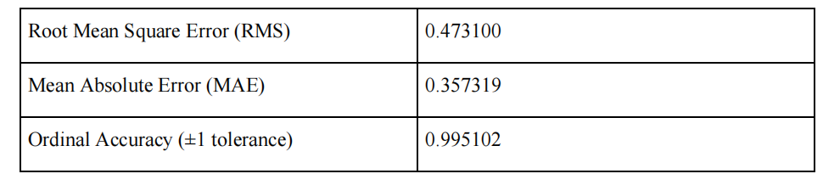
XGBOOST-based Risk Modelling
XGBoost regressor trained using deep image features from trained CNN and statistical thermal features
Model predicts neuropathy risk on an ordinal risk scale
Risk interpretation: 0.0–0.5 → Low risk, 0.5–1.5 → Moderate risk, > 1.5 → High risk
Dataset used: 21,660 training and 6,330 validation images (27,990 total) with risk labels
Confusion matrix shows strong separation between risk categories
Minor overlap near boundaries, expected in medical ordinal prediction
Confusion Matrix
Validation Performance

Slide 16
Comparative Analysis: CNN-only vs. Hybrid Model
The CNN-only model demonstrated higher error metrics (RMSE: 0.6102, MAE: 0.4989) compared to the Hybrid model.
The hybrid approach provides several key advantages, including improved separation between risk classes and a better alignment with the physiological characteristics of neuropathy. Furthermore, this method results in enhanced model interpretability and more reliable predictions.
Handcrafted thermal features are essential for better neuropathy risk estimation.
 | Hybrid features model | CNN-features only model
Root Mean Square Error (RMS) | 0.473100 | 0.610200
Mean Square Error (MAE) | 0.357319 | 0.498862
Ordinal Accuracy | 0.995102 | 0.99162

Slide 17
Desktop Application for Real-time Prediction
Python-based User Interface
Framework: Developed using the Tkinter library for a lightweight and efficient GUI.
Core Components:
Image Display Panel: Shows the uploaded thermal foot image.
Control Buttons: For image uploading and triggering risk prediction.
Result Area: Displays the predicted risk level (Low, Moderate, High) and numerical score.
Runtime Models: Loads the MobileNetV2 feature extractor, StandardScaler, and XGBoost regressor simultaneously.

Slide 18
Application Workflow and Risk Mapping
System Process
Image Upload: Supports PNG/JPG thermal image formats.
Hybrid Extraction: Generates 1292 total features (1280 CNN + 12 Thermal).
Feature Scaling: Normalizes the combined vector using StandardScaler.
Risk Prediction: XGBoost regressor computes a continuous risk score.
Output Mapping:
Low Risk: Score <= 0.5
Medium Risk: 0.5 - 1.5
High Risk: Score > 1.5

Slide 19
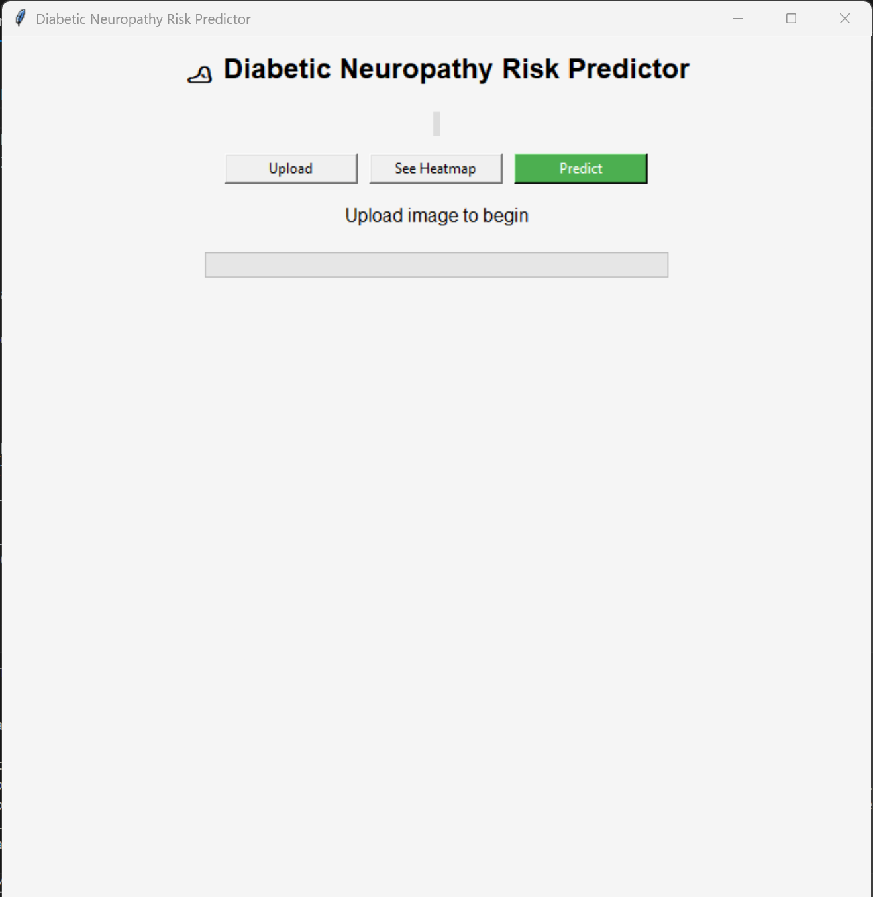
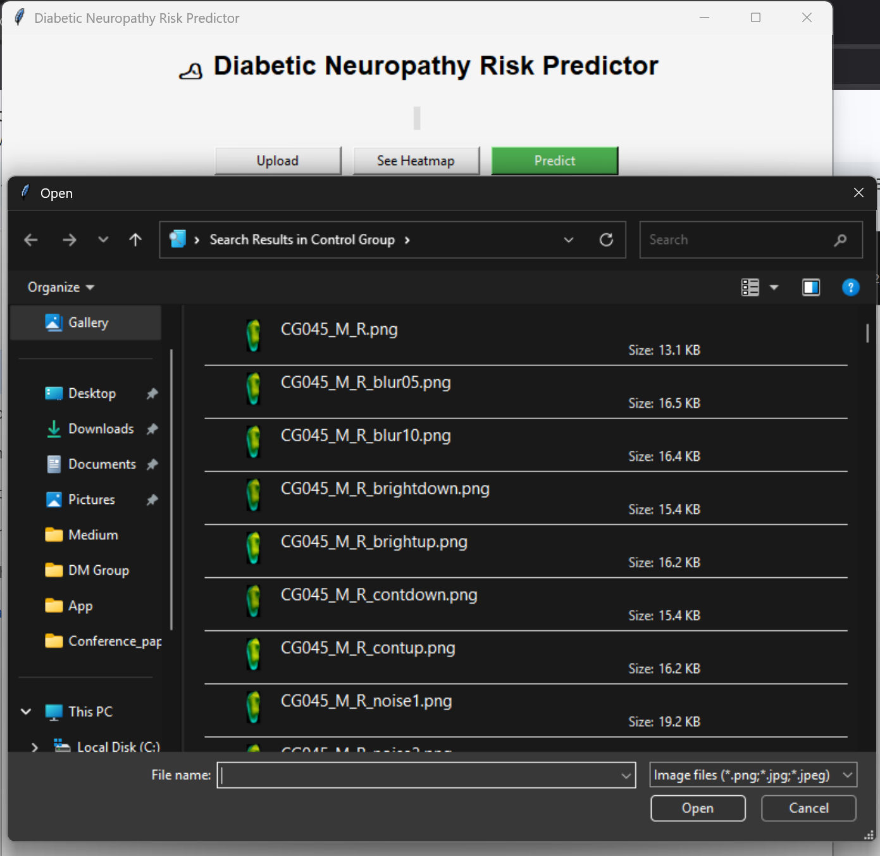
Application User Interface : opening and file selection menu

Slide 20
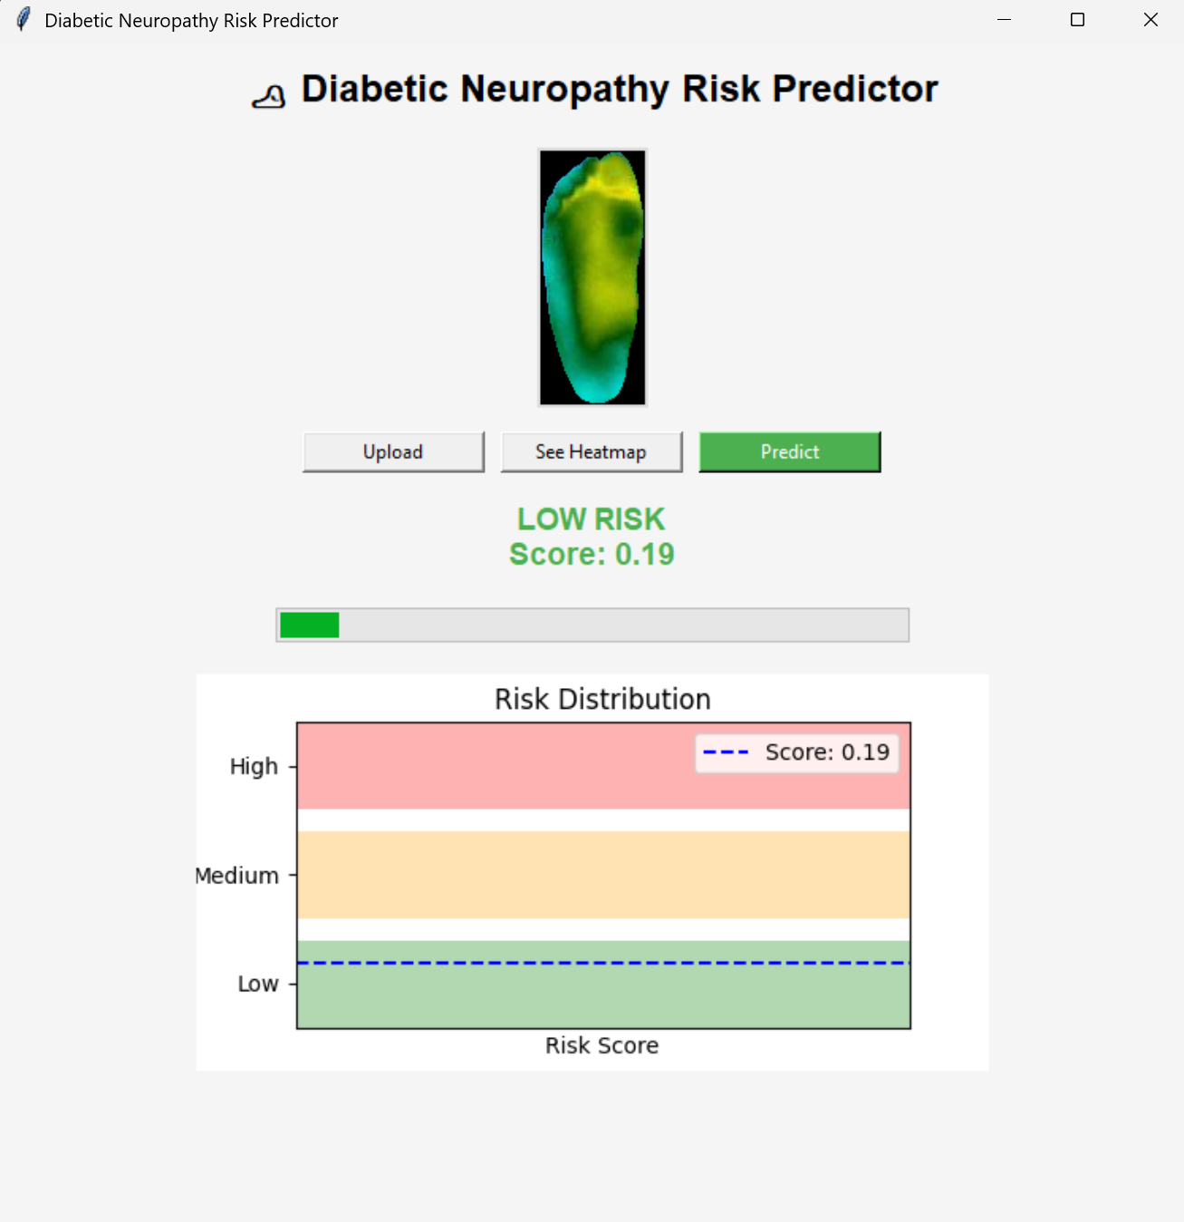
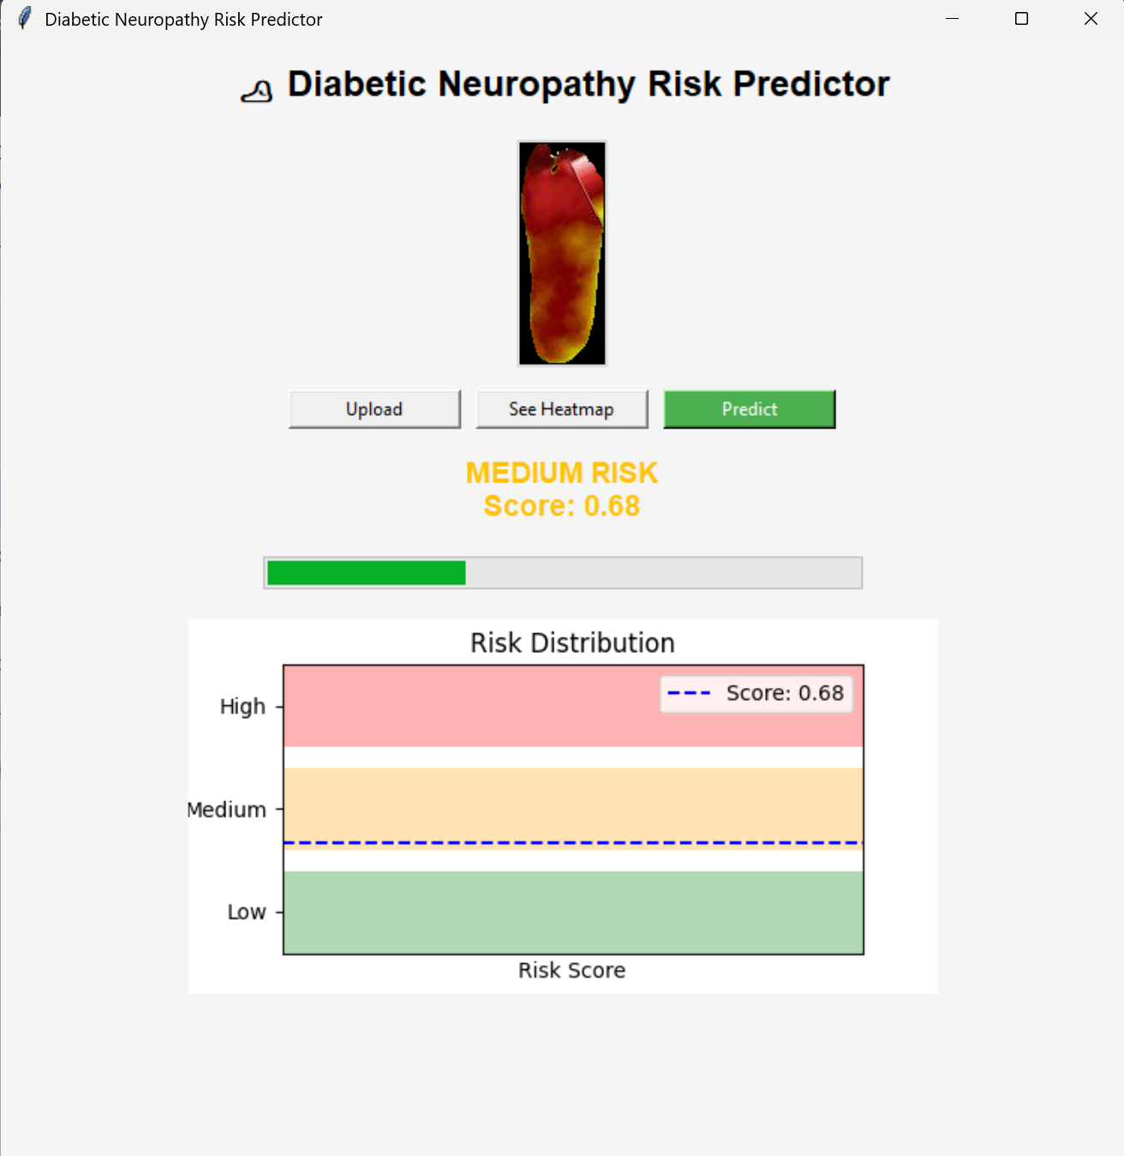
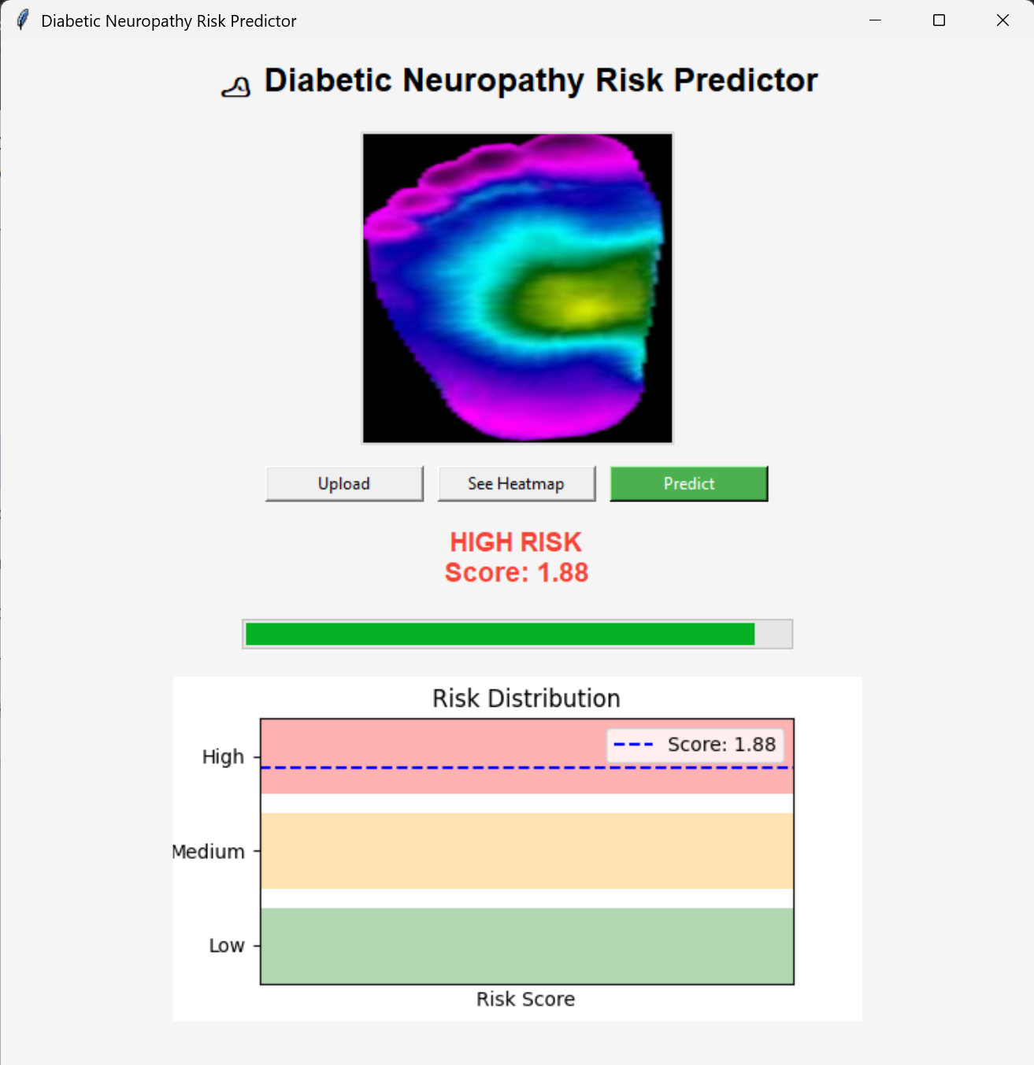
Application User Interface : model predictions for different input images

Slide 21
Future Scopes
Domestic level application: The system could be integrated into smartphone based applications and would allow convenient home based monitoring using portable thermal cameras.
Expansion incorporating multi-disease detection: The system could be expanded to detect other diabetic foot conditions and vascular disorders using the same thermal imaging approaches.
Deployment in Rural Healthcare Centers: The lightweight and low-cost nature of the framework makes it suitable for deployment in rural and resource-constrained healthcare environments, improving accessibility to early diabetic neuropathy screening.

Slide 22
Conclusions
Developed a smart and non-invasive system to predict diabetic neuropathy risk using foot thermal images.
Combined deep learning with thermal feature analysis for more reliable results.
Introduced a Thermal Risk Score (TRS) to provide better understanding of risk levels instead of simple yes/no predictions.
The system can support early detection, continuous monitoring, and faster clinical decision-making.
With further improvement and larger datasets, the framework has strong potential for real-world healthcare applications.

